Slide 1
Data Visualization in Python
with Yuhang and Michael

Slide 2
Data Viz in Python - Matplotlib
Python 2D plotting library
Produces publication quality figures with just a few lines of code
Generates standard plots like histograms, bar charts, scatterplots, and line charts.
Full control of line styles, font properties, axes properties via an object oriented interface
https://matplotlib.org/
https://matplotlib.org/gallery/index.html

Slide 3
Data Viz in Python - Demos
Data - Historical Hourly Weather Data 2012-2017
Data Manipulation - Transform raw data into viable visualization format
Line and Area Chart - Daily temperature range over time
Map Chart - Average temperature change by location (mplleaflet)
Time for questions at the end of each demo

Slide 4
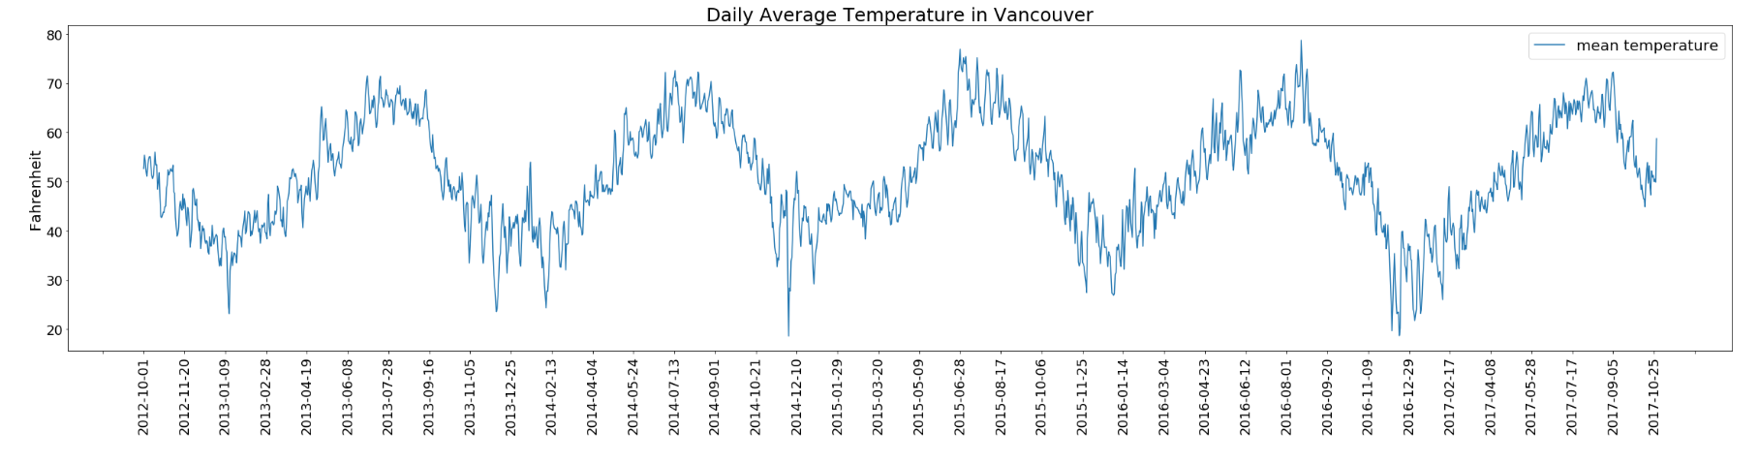
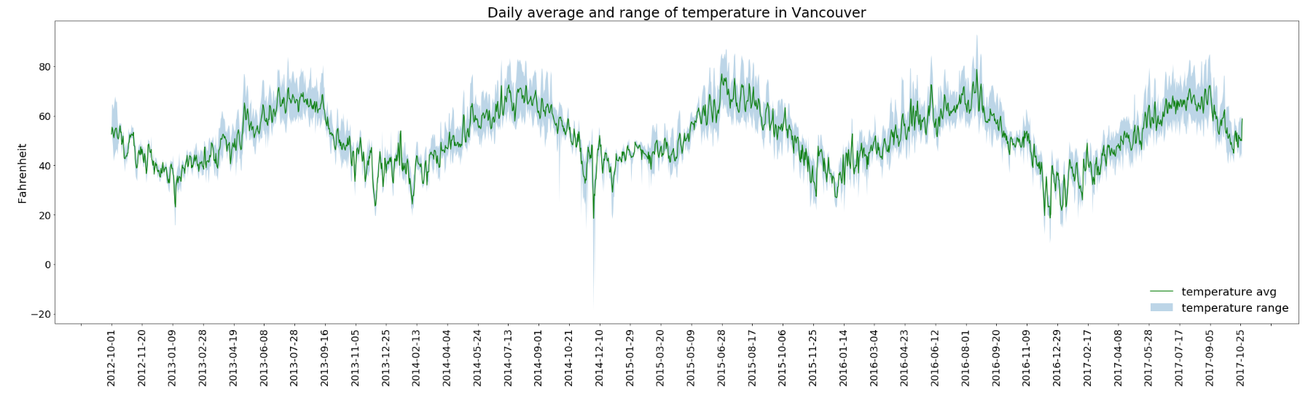
Data Viz in Python - Line and Area Chart Demo

Slide 5
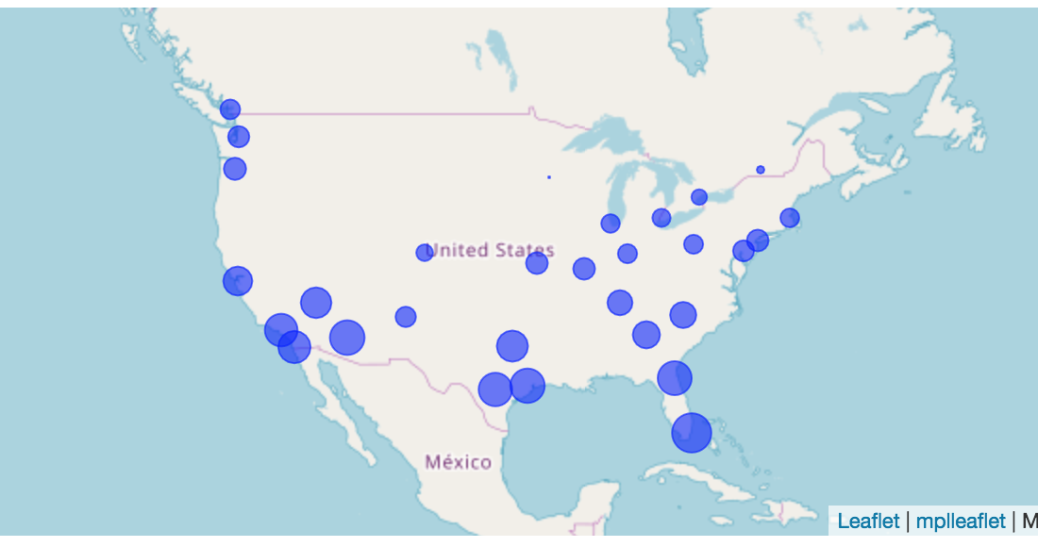
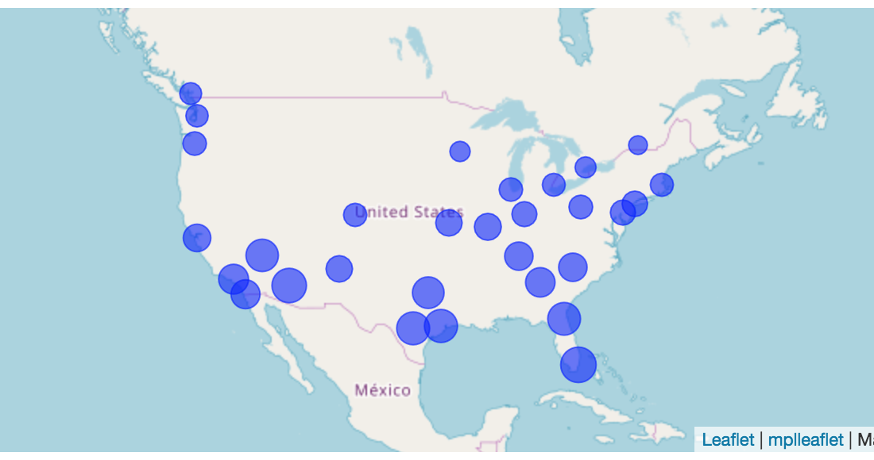
Data Viz in Python - Map Chart Demo
Average Temperature 2012
Average Temperature 2017

Slide 6
Thank you

